Slide 1

TechRiot – MVP Demo
Unified Automation Framework -Web and Mobile
Paarrivanan, Lavanya,
Bala, Sravani
17/1/2022

Slide 2


Unified Automation Framework - Web and Mobile
Tool Evaluation Criteria – Open Source, Inhouse JS based framework, Functional Testing, API Testing, Mobile Testing, Unit Testing, Performance Testing, Benchmarking, Scalability, Community Support, Easy setup & Installation, Jira/Xray Integration, Maturity, Enterprise Readiness, Portable, CI and Reports
Supports multiple browsers(Chrome, Safari, Opera , Firefox, MSEdge)
Handles multiple tabs and iframes
Supports services from Appium for mobile testing
Smart locator strategy CSS, Xpath etc.
Supports TDD and BDD frameworks
Supports chromium-based browsers and firefox
No support for multiple browser tabs, cypress do not drive 2 browsers at same time. Iframe support is limited
Cypress will never be able to run on a native mobile app
Supports CSS only there is a plugin you can add to use xpath
All in one testing framework, assertion library, with mocking and stubbing
Supports multiple browsers(Chrome, Safari, Opera , Firefox, MSEdge)
Handles multiple tabs and iframes
Supports services from Appium for mobile testing but not well documented
Supports CSS, Xpath etc.
Not much choices for unit test frameworks as it has an own framework

Slide 3
1
1
Technical Implementation & Capabilities Built
Agenda
2
MVP Demo
1
3
Webdriver.io Capabilities

Slide 4









Technical Implementation & Capabilities Built
A
L
LU
R
E
R
E
P
O
R
T
S
MVP - Capabilities Built
Selenium Standalone
Server
W3C Protocol
Web Automation - Cross Browser & Parallel Testing
Mobile Automation - Emulators Parallel Testing
Desktop App
API Testing & Performance - Web & API
Batch Run & Scheduler
Jira & Xray Integration
Reports - Allure Reports, Junit Reports, Json Reports
Web
Common Code
Stability
Standards
Appium Server
W3C Protocol
Mobile
Tech Stack
Web | Mobile | API | Desktop
Cucumber BDD, JS, Node.js, Allure Reports, VS Code | Mocha, TS, Node.Js, Android Studio, Appium server, Appium doctor, Allure Reports, VS Code, Junit reports | Mocha, Node.Js, Artillery, Autocannon | Cucumber, WinApp Driver, Appium Server,
Desktop
WinApp Driver/ Appium Server
W3C Protocol
JS
O
N
Artillery/
Autocannon
http
WebSocket
API & Web Performance

Slide 5
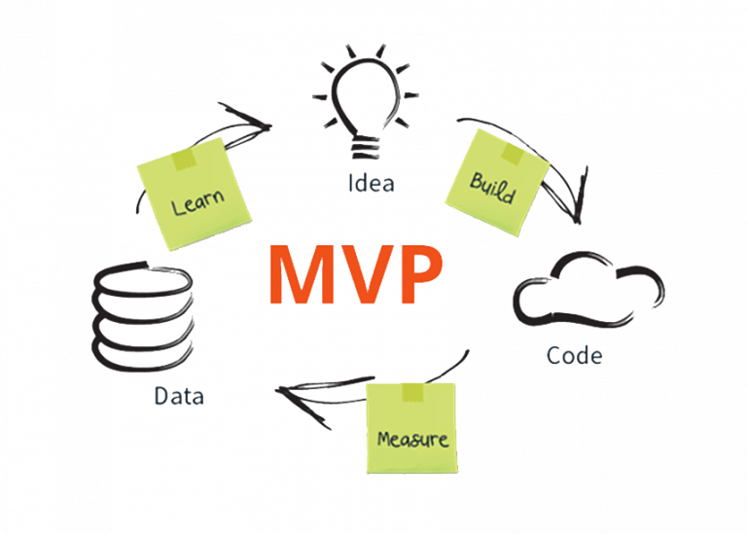
MVP Demo Follows
Demo

Slide 6

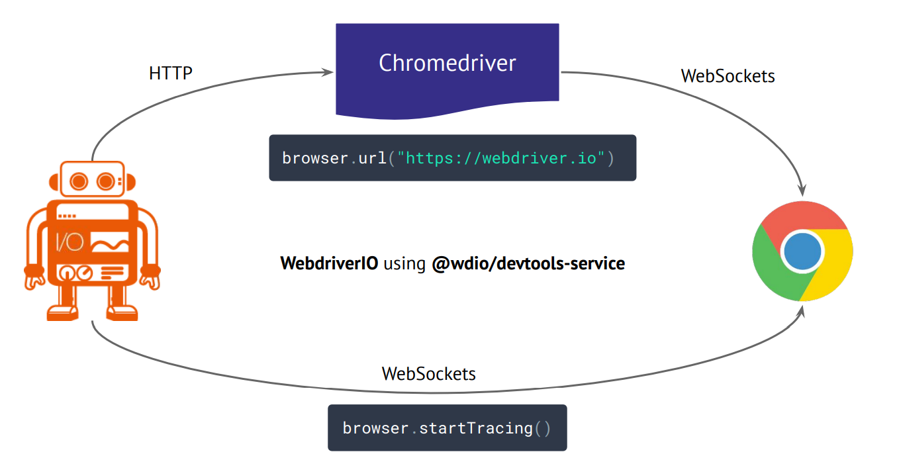
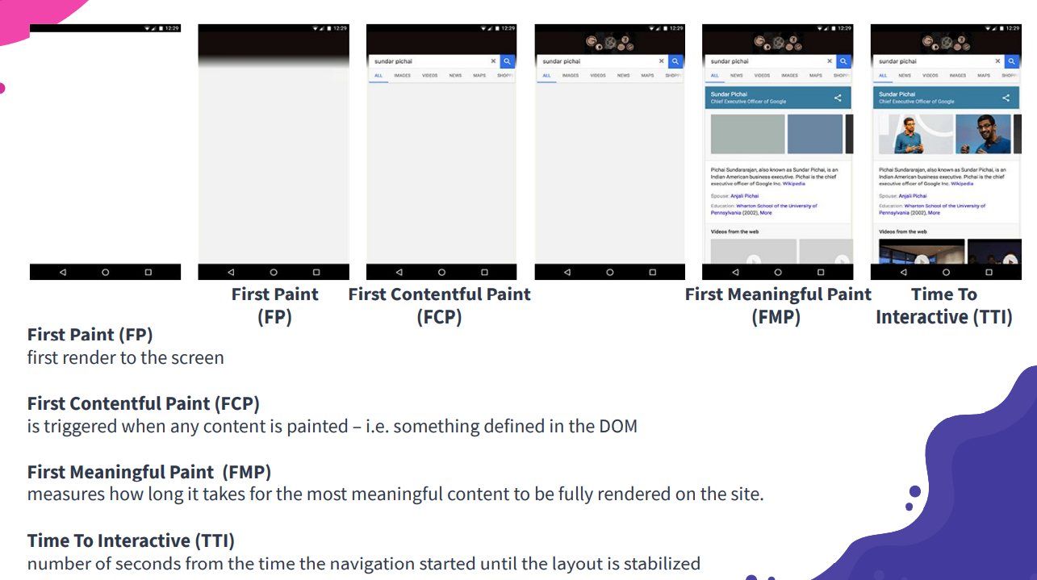
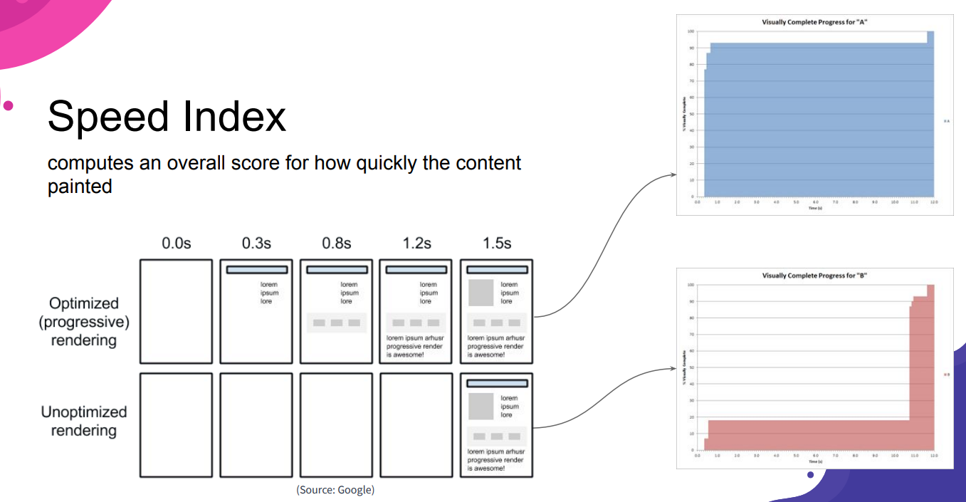
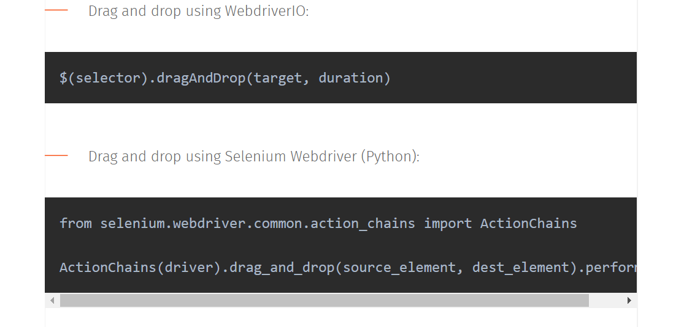
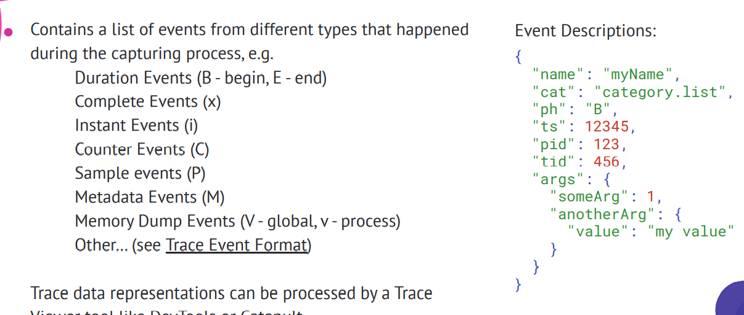
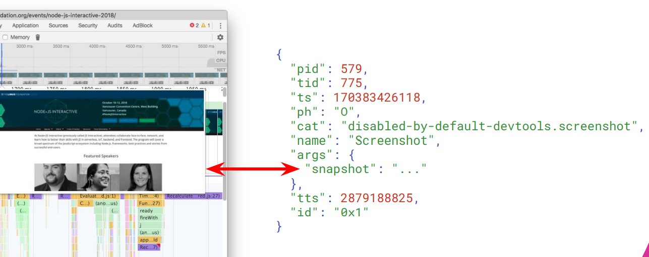
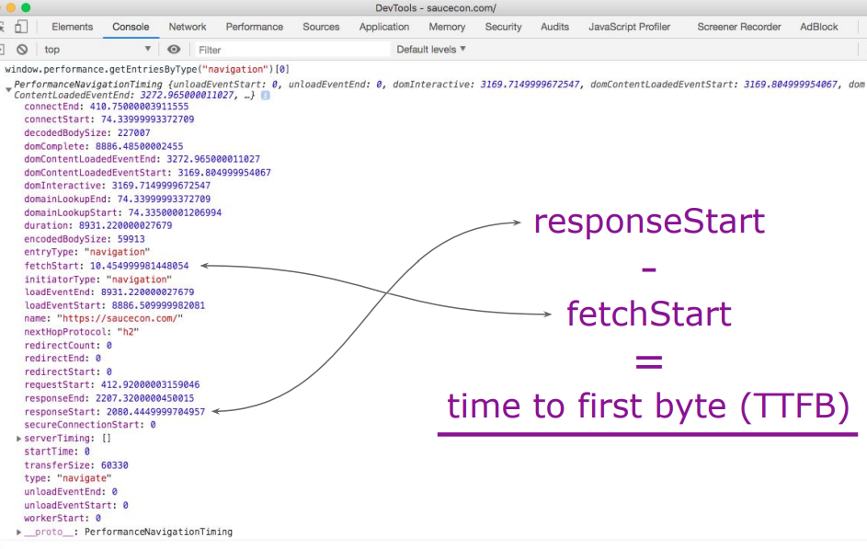
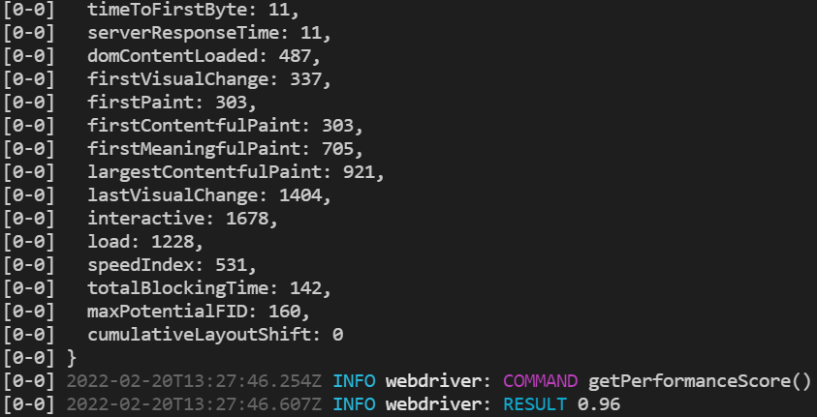
Webdriver.io Capabilities
#Recommended by W3C
#Open Source
#Parallel Testing
#Cross Browser Testing
#Easy Reports Integration
#Modern Web Frameworks
#Multiremote
#Jira/Xray Integration at ease
#API Testing
#Easy Setup & Installation
#Smart Selectors
#Programming skills need minimized
#Chatbot
#Inhouse Unified JS Framework
#Desktop Automation
#Cloud Services
#Visual Regression
#Dockerization
#Benchmarking
W3C WD Protcol

Slide 7
Thank You
Team: Paarrivanan, Lavanya, Bala, Sravani
References:
Official Doc
WebdriverIO · Next-gen browser and mobile automation test framework for Node.js |

